Slide 1
Data Professional Survey
Presented By:
NEEHA DADI
Batch: 2022-7494

Slide 2
Project Description
This project is about creating a dashboard which makes users easily interpret various aspects in data field such as:
countries with opportunities
Salary
different roles in the field
Age & Gender
work-life balance
Here I choose Power BI tool for visualization of my data.

Slide 3
Project Description Continue…
The Dashboard is prepared after:
Collecting Data
Exploring Data
Cleaning and Manipulation of Data
Modelling of Data
Visualization of Data

Slide 4
Dataset
The dataset is taken from GitHub.
This dataset contains data which is collected by conducting an online survey from October 2022 to December 2022 regarding data professions.
The dataset is an excel workbook which contains 630 rows representing the no. of survey takers and 28 columns representing various aspects such as Unique Id, Current role, Age, Salary, Gender, Switched to data field, working industry, how happy they are with work-life balance., etc.
This dataset is connected to Power BI by selecting Excel Workbook in Data section of Home tab. Before loading it, the data should be transformed in power query.

Slide 5
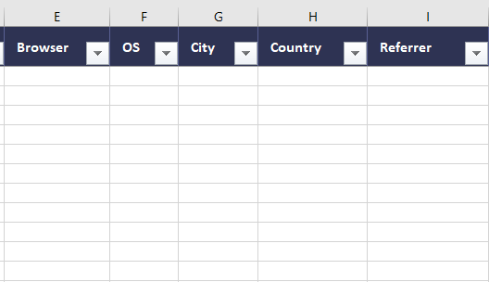
Data Exploration
Data exploration is the important step in BI where the data is completely checked for null values, empty fields and unwanted data before cleaning the data.

Slide 6
Data Cleaning and Manipulation
In data cleaning, the unwanted columns are removed using Remove columns function in Manage columns section of Home tab.
Data Manipulation functions used in this project:
Replace values
Split column
Filtered rows
Changed type
Duplicate column
Custom column

Slide 7
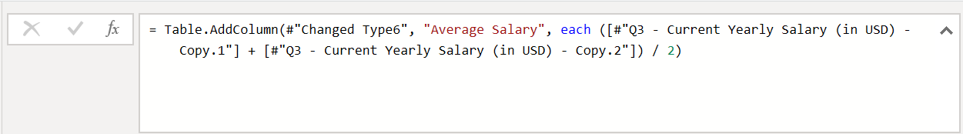
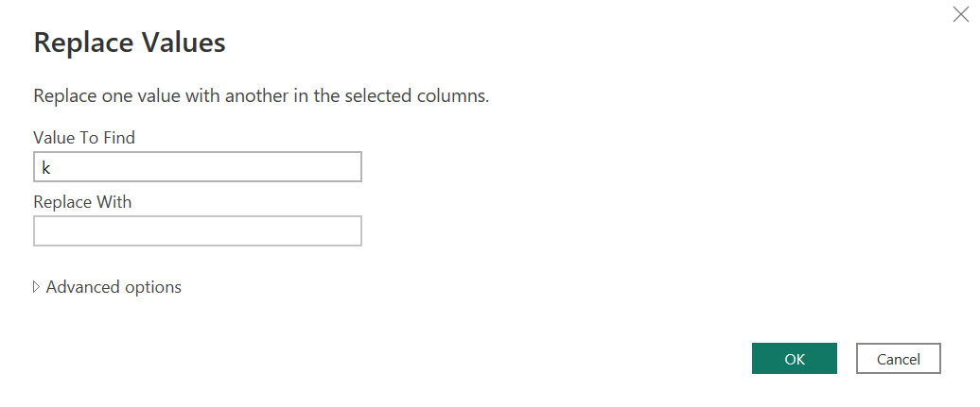
Custom column using formula
Replacing value k with empty space

Slide 8
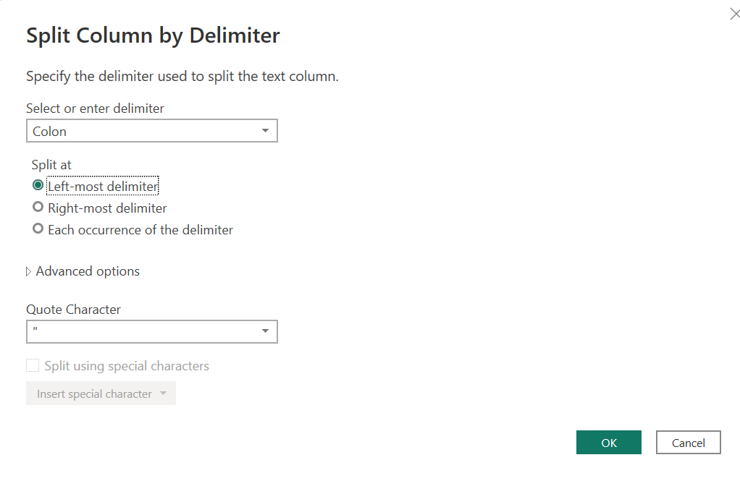

Slide 9
Data Visualization using POWER BI
Visualizations used in this project:
Slicer
Card
Pie chart
Stacked Bar chart
Stacked column chart
Tree Map
Gauge
Donut chart

Slide 10
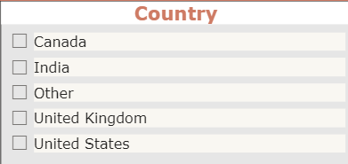
Slicer
Created Slicer by adding ‘Which country do you live in?’ column into the field.
Formatted the font, font size, slicer header and color of text and background color.
We can also add select all option in slicer settings section.
Can also restrict the changes in other visuals using Edit Interactions option in Format tab.

Slide 11
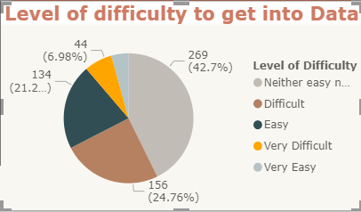
Pie Chart
‘How difficult was it to break into Data?’ column is added as legend and the count of the same column is added as values.
There are five categories in this column which are assigned with different colors.

Slide 12
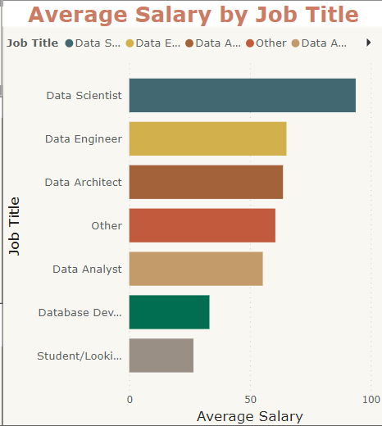
Stacked Bar Chart
Current job role is added as Y-axis.
Average Salary is added as X-axis.
Current job role is added as Legend.
This visual gives an idea about average salary that is obtained for different roles in data field.

Slide 13
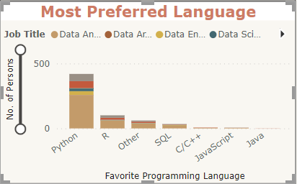
Stacked Column chart
Favourite programming language is added as X-axis.
Unique Id is added as Y-axis.
Current job role is added as legend.
Zoom slider is enabled to have a clear visualization when needed.
This visual draws a picture about which language is preferred by most of the data employees.

Slide 14
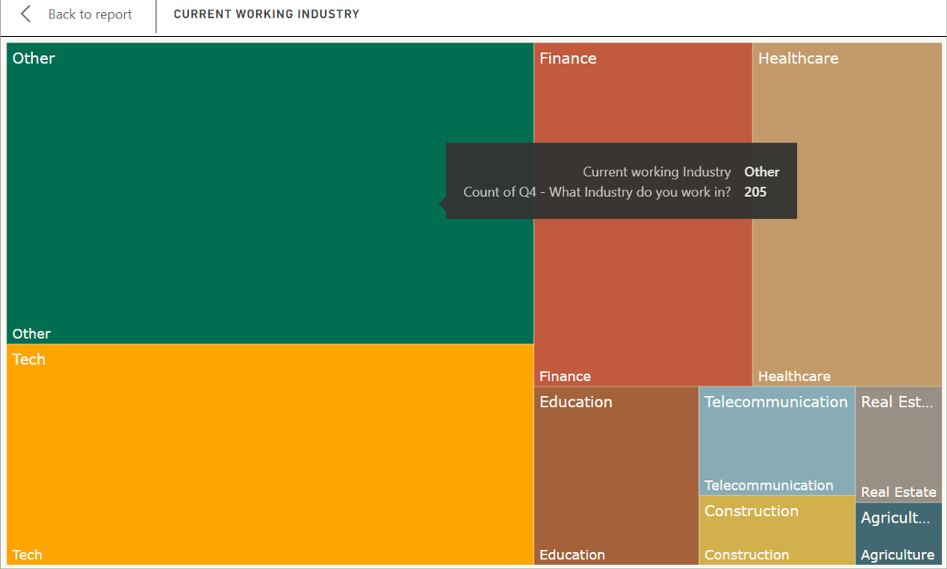
Tree Map
Current working industry of the survey takers is added as category.
Count of the same is added as values.
This visual gives an idea which industry is having highest data field job roles.

Slide 15
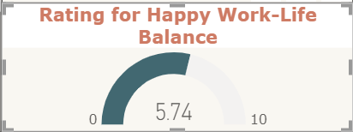
Gauge
‘How happy are you in current position with the work/life balance?’ is collected in the survey.
In this visual the minimum and maximum ratings given by them are considered as minimum and maximum values. The average of all the values is considered as the gauge value.
This visual tells us on what scale the surveyors have work/life balance.

Slide 16
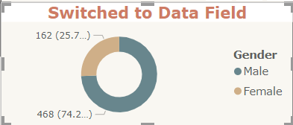
Donut chart
Here we used this visual to show how many among the surveyors have switched their field to Data field on gender basis.

Slide 17
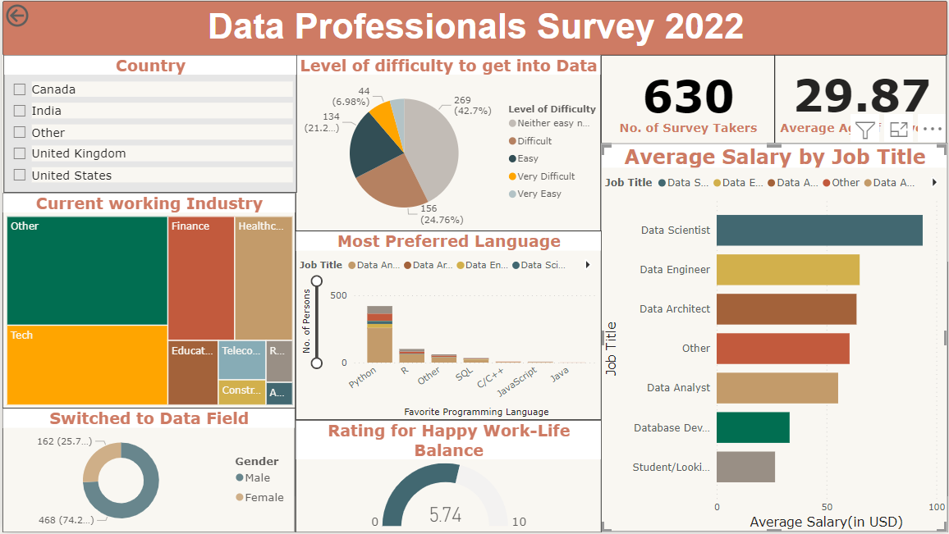
Dashboard

Slide 18
Conclusion
This dashboard is useful for the students or working professionals who are looking forward to start a career or shift role or improve skills in Data field based on their country, age and gender.
Average Salary obtained for different roles in different countries.
Percentage of Males and Females shifted their career to Data field.
Scope for Data roles from different industries.

Slide 19
THANK YOU

